Slide 1
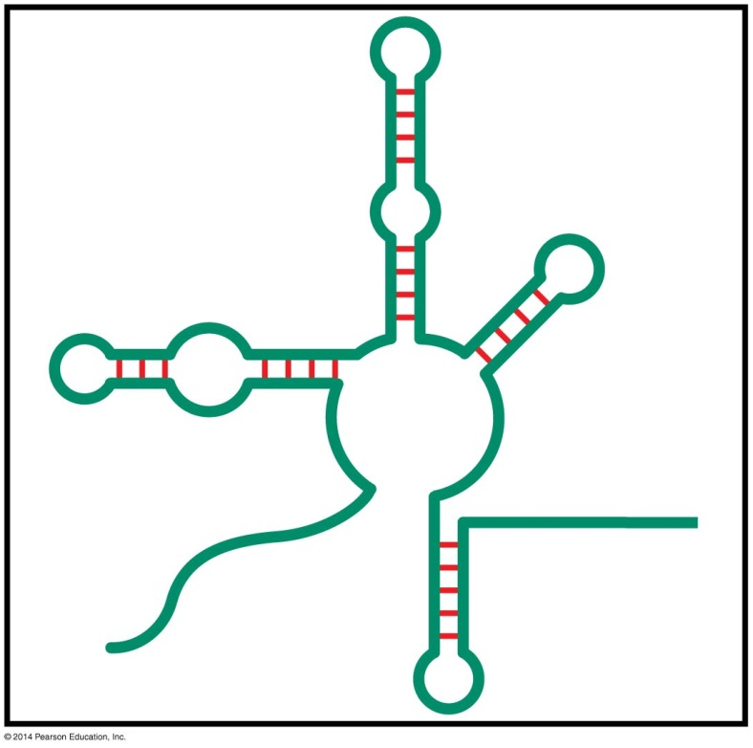
Regulatory RNAs
BT 454
Chapter 20

Slide 2
Regulation by RNAs in Bacteria

Slide 3
Regulatory RNA
In most cases regulator means a protein which act as activator or suppressor
RNA as regulator was rediscovered in the 1990s

Slide 4
Function of regulatory RNA in Bacteria
Regulating plasmid replication
Regulating gene expression
  By producing antisense RNA
  Binding to σ⁷⁰ subunit of RNA polymerase
Regulating translation
Regulating mRNA degradation (RybB RNA)

Slide 5
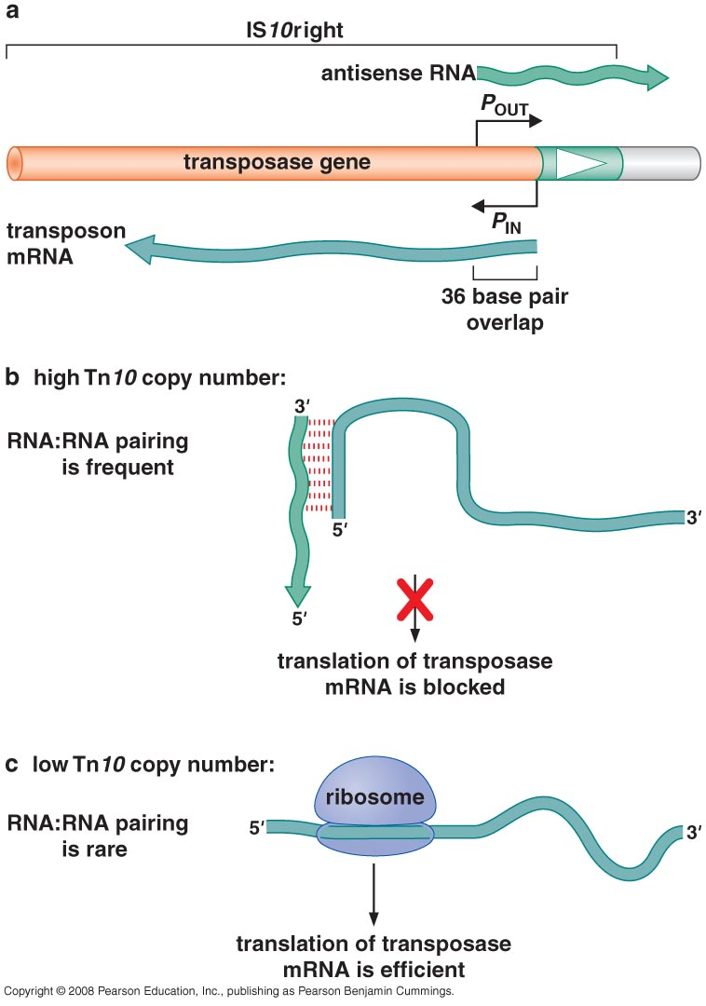
1- Regulating gene expression
Producing antisense RNA
antisense RNA: they are encoded by the strand opposite the coding strand of a gene and act through homologous base pairing to inhibit expression of the mRNA produced from that gene.
These tend to be associated with genes encoding potentially toxic products, and also in regulation of some phage genes

Slide 6
2- Regulating gene expression
Binding to σ⁷⁰ subunit of RNA polymerase
↓ nutrients → bacteria goes into stationary phase
Need to express genes suitable for stationary phase → σ^{S}
To shift transcription from house keeping genes by σ⁷⁰ to genes by σ^{S} → 6S RNA is highly produced to bind to σ⁷⁰ and prevent transcription.

Slide 7
Bacterial regulatory RNA
Small RNA (sRNA)
80-110 nucleotide
Encoded by small genes
Work by base pairing with complementary sequences
This binding require a chaperon (Hfq protein)

Slide 8
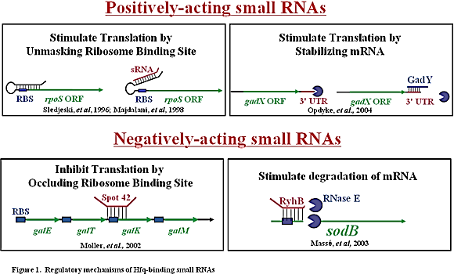
3- Regulating mRNA degradation
Achieved by small RNA (sRNA)
Example is RybB
Bind to mRNA & target it for degradation
Needs Hfq chaperon for binding:
  Strengthen the binding between sRNA & mRNA
  Increase stability of sRNA
RybB

Slide 9
3- Regulating mRNA degradation sRNA (RybB)
Regulate level of free Fe
  ↑ ↑ Fe → Fe binding proteins is needed → mRNA should not be degraded → RybB does not bind mRNA
  ↓ ↓ Fe → Fe binding proteins is NOT needed → mRNA should be degraded → RybB binds mRNA → Fe is free

Slide 10
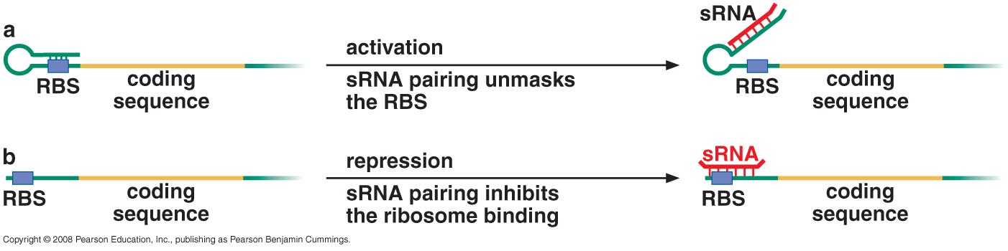
4- Regulating translation
This is an example of trans-acting regulatory RNA
When the same mRNA include a part for regulation this is known as cis-acting

Slide 11
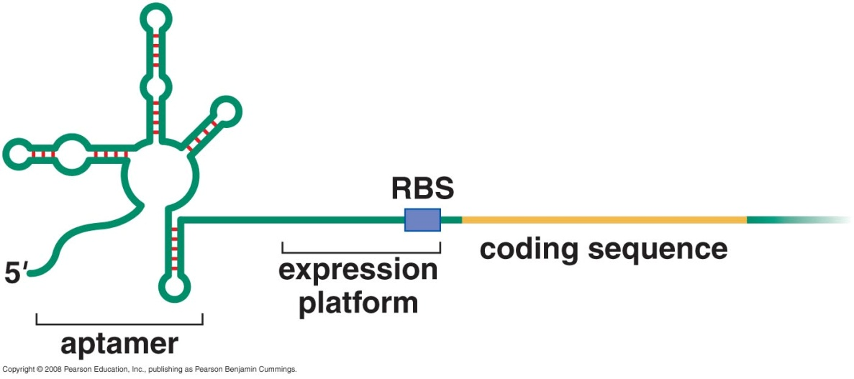
Cis-acting riboswitches
The aptamer binds the small-molecule ligand and, in response, undergoes a conformational change, which, in turn, causes a change in the secondary structure of the adjoining expression platform.
These conformational changes alter expression of the associated gene by either terminating transcription or inhibiting the initiation of translation.

Slide 12
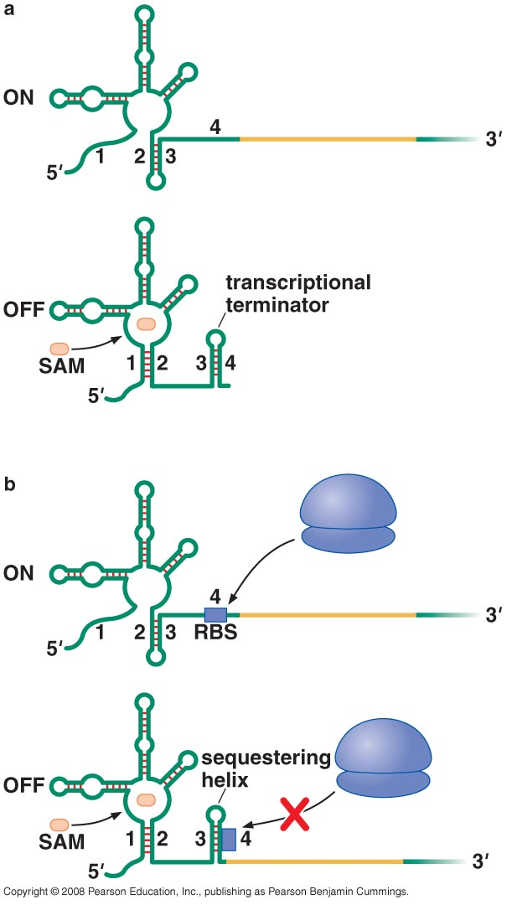
Riboswitches regulate transcription
Control metabolic operons
Control expression in response to changes in concentration of small molecule
Located at 5` UTR
Can regulate transcription and translation

Slide 13
Riboswitches regulate translation

Slide 14
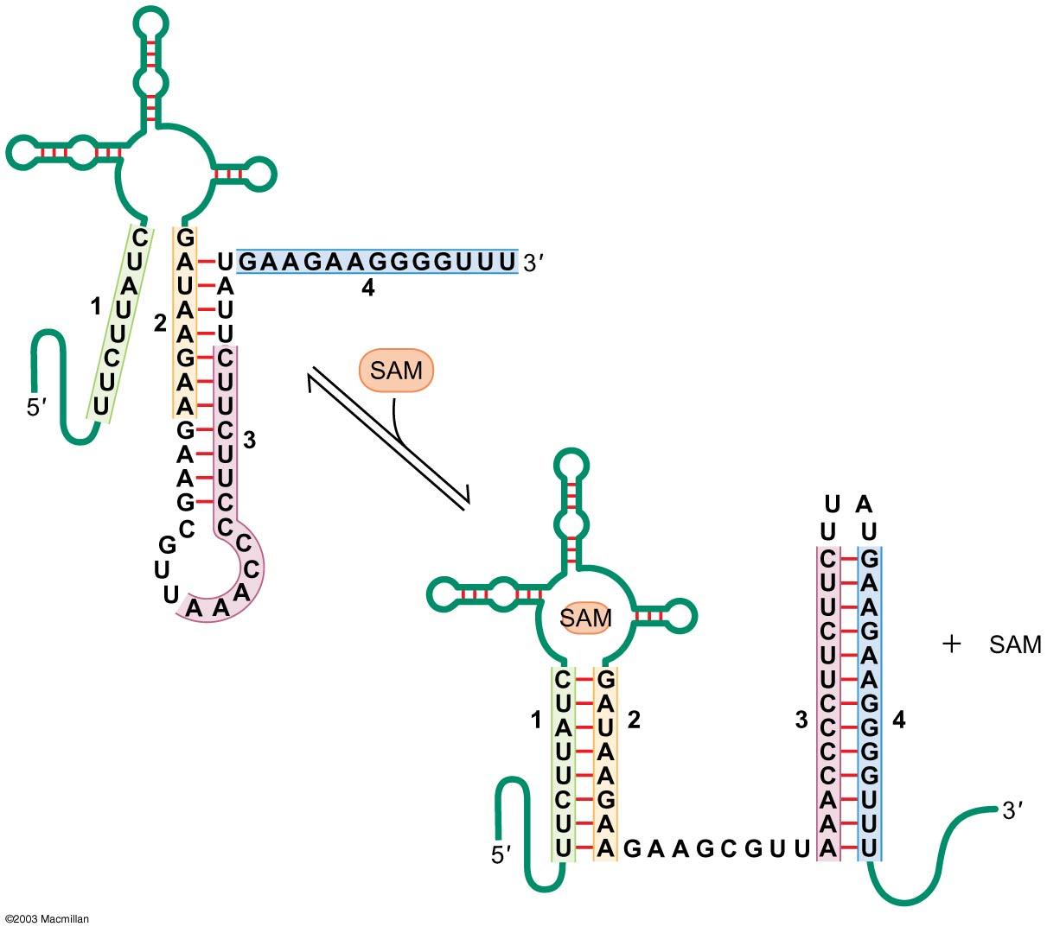
A closer look
Bacillus subtilis:
many genes involved in the use of the amino acid methionine have a 200-nucleotide-long untranslated leader RNA that acts as a SAM (S-adenosylmethionine)–sensing riboswitch.

Slide 15
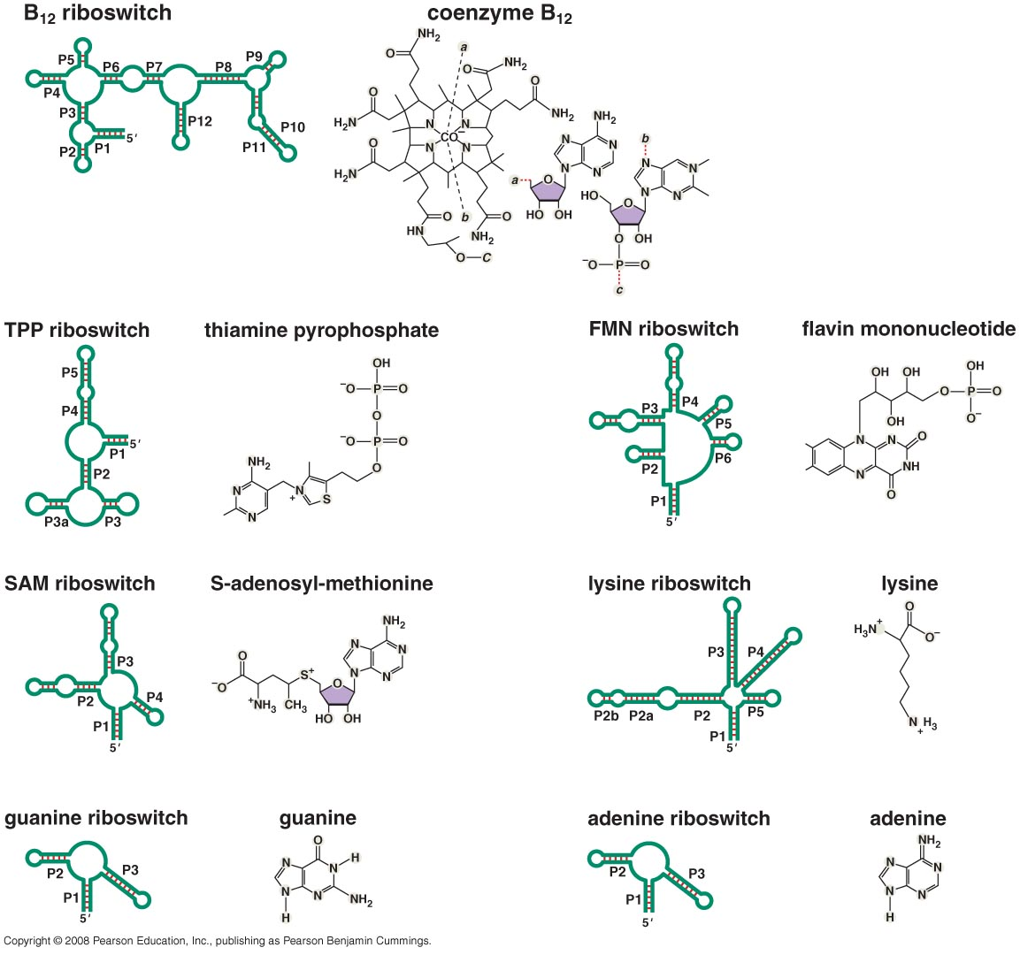
Riboswitches respond to range of metabolites

Slide 16
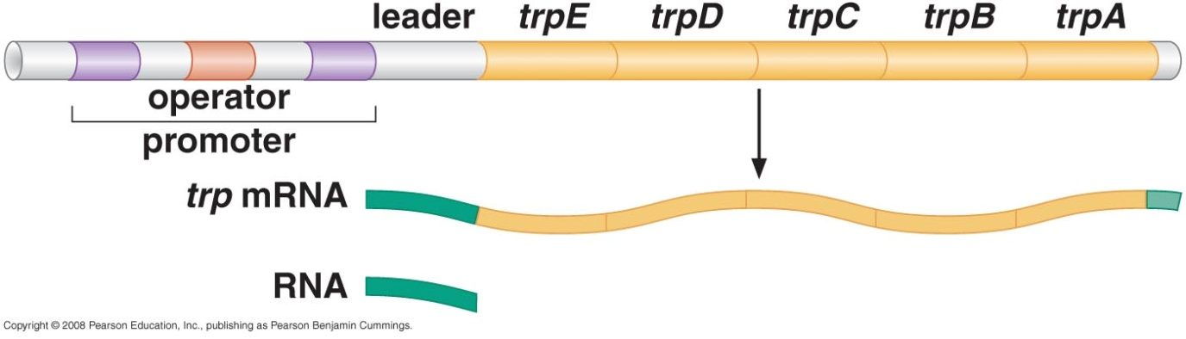
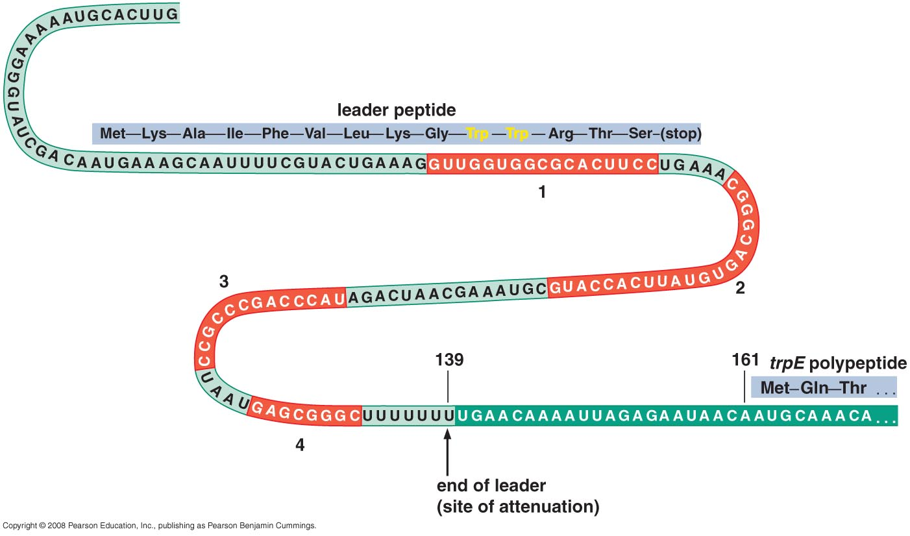
Transcriptional attenuation of Trp operon

Slide 17
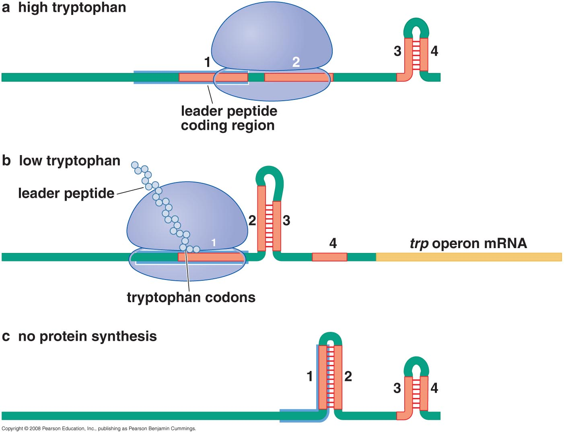
Transcriptional attenuation of Trp operon

Slide 18
5- sRNAs machinery to destroy infecting phage and plasmids in Bacteria
CRISPR system: Clusters of characteristic repeating DNA sequences (different in each cluster) give rise to a special class of sRNAs that direct a protein machinery to destroy infecting phage and plasmids ( any foreign DNA that finds its way into the cell)
The ability to distinguish “self” from “non-self” stems from the fact that the CRISPR regions accumulate fragments of phage genomes from earlier infections and these determine the sequence of the targeting RNAs.

Slide 19
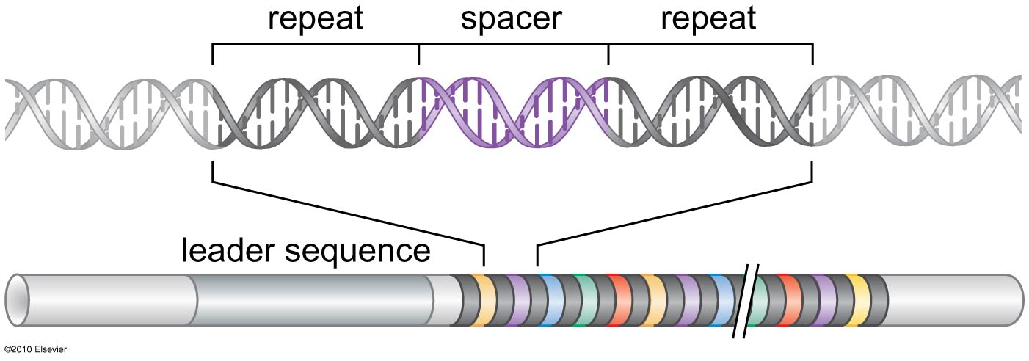
Figure 20-6
The organization of the CRISPR locus
repeating DNA sequences
Notes:
Figure 20-6
©2010 Elsevier
http://www.sciencedirect.com/science/article/pii/S109727650900968X

Slide 20
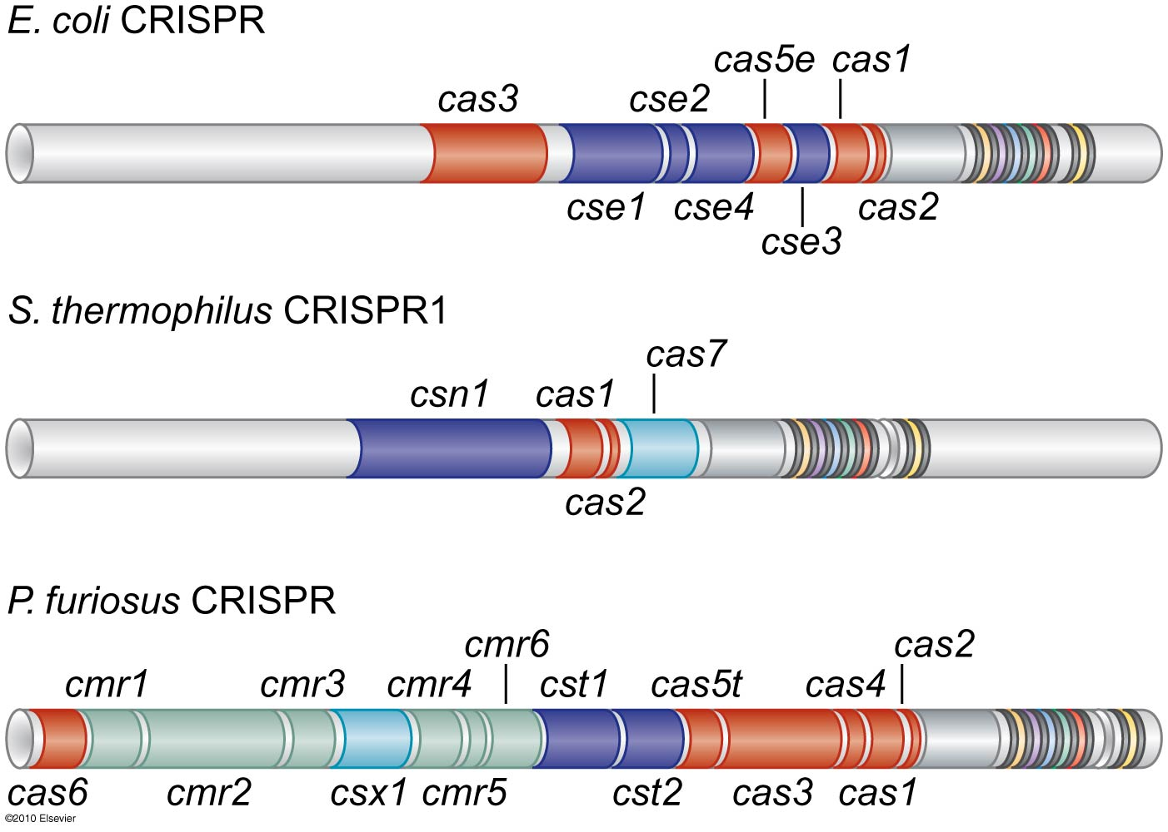
Figure 20-7
The two most highly conserved members associated with CRISPR (cas1 and cas2) are found in all cases.
cas vary in numbers and orientations among different bacteria.
The core cas genes are shown in red and closely conserved in the three well studied CRISPR loci.
Notes:
Figure 20-7
©2010 Elsevier
http://www.sciencedirect.com/science/article/pii/S109727650900968X

Slide 21
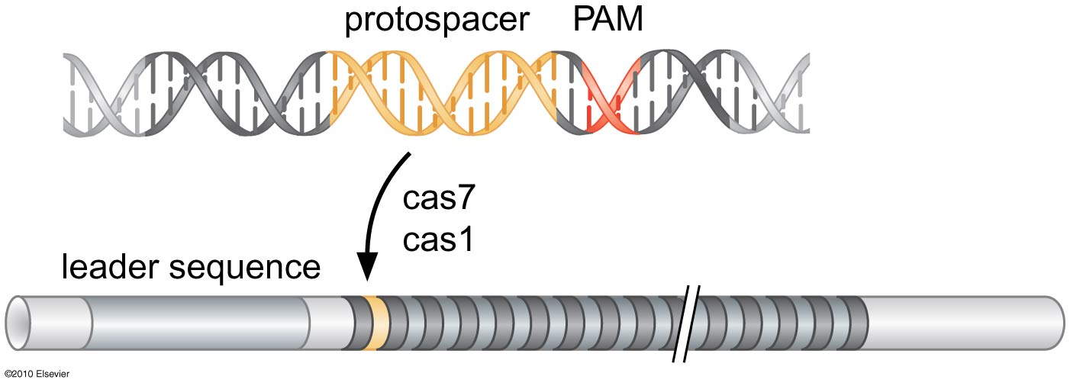
Figure 20-8
The mechanism of spacer sequence acquisition:
The sequence in the virus that will become a new spacer is called the proto-spacer and is found close to a PAM (proto-spacer adjacent motif) sequence.
When a new spacer is added to a CRISPR array, it is incorporated at the proximal end, near the leader sequence.
acquisition by a cell of spacer regions from a given phage confers decreased sensitivity to further infection by that phage.
Notes:
Figure 20-8
©2010 Elsevier
http://www.sciencedirect.com/science/article/pii/S109727650900968X

Slide 22
A CRISPR Is Transcribed as a Single Long RNA, Which Is Then Processed into Shorter RNA Species That Target Destruction of Invading DNA or RNA
The promoter from which expression is initiated is located within the leader region and generates a single RNA transcript called the pre-crRNA.
In the case of E. coli, the CRISPR is associated with eight cas genes, the products of five of which form a complex called Cascade.

Slide 23
This complex includes one subunit that is implicated in the processing of the long transcript into the individual short crRNAS, each the length of one spacer and one repeat sequence.
These small RNAs remain bound to the Cascade complex and direct it to the DNA genomes of invading foreign DNA.
In other cases (e.g., Pyrococcus furiosus), processing of the by an alternative protein complex made up of a different collection of Cas proteins (Cmr-complex)
In this case, the crRNAs start out with the 50 and 30 handles, but the 30 handle is trimmed off in a subsequent processing step.
In this case, the crRNA–protein complex is directed against foreign RNA rather than DNA.

Slide 24
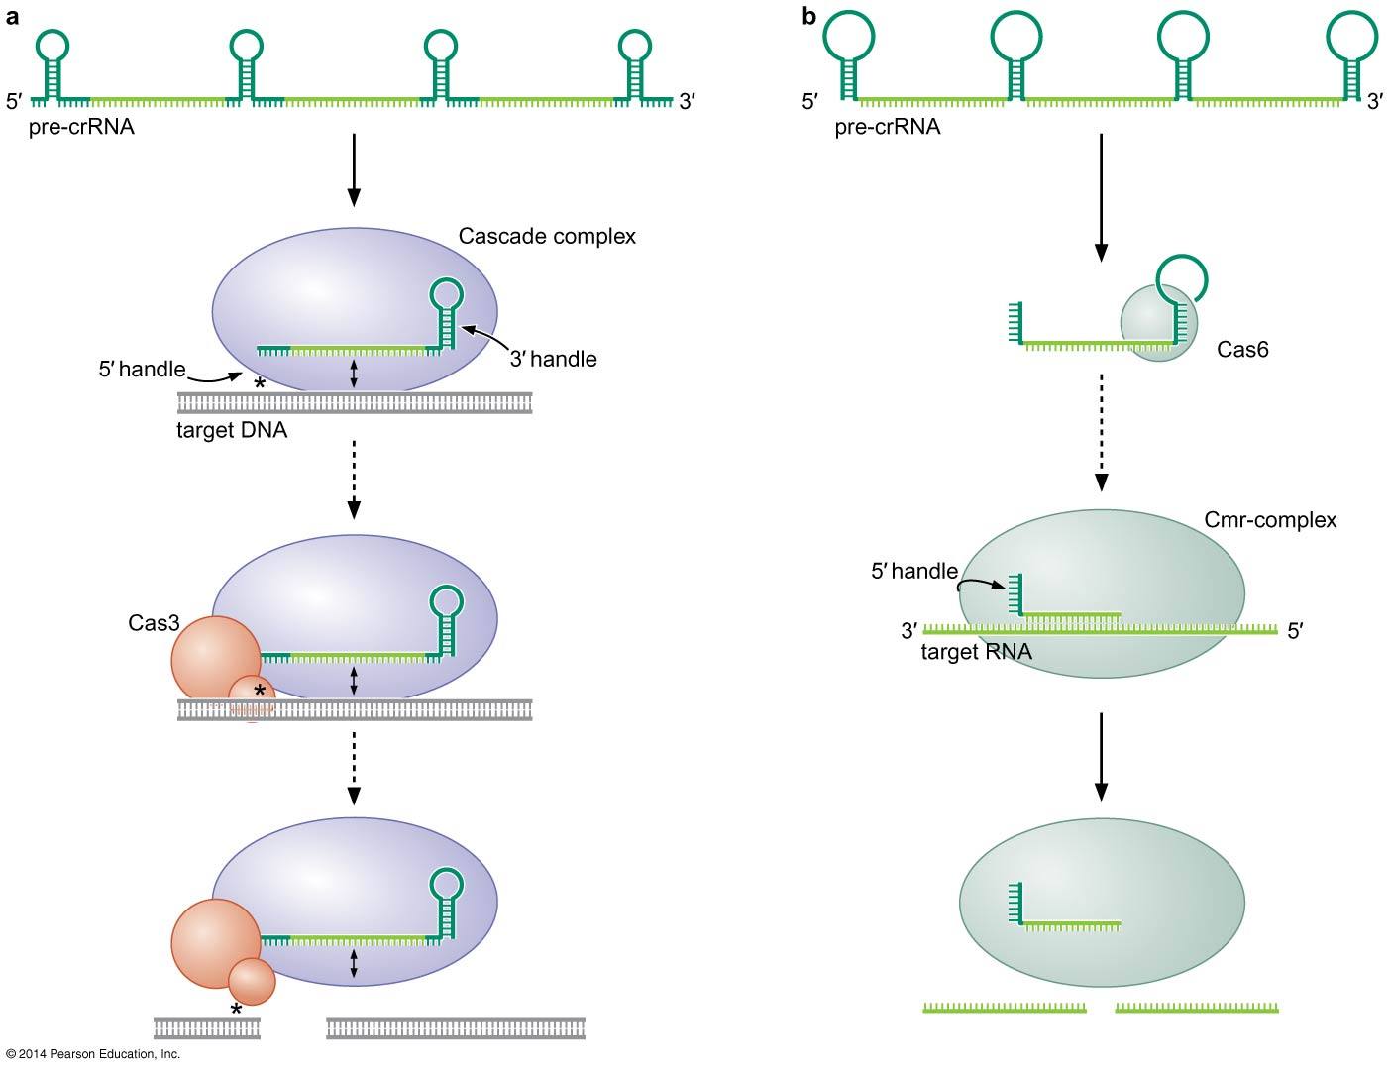
Figure 20-9
Notes:
Figure 20-9

Slide 25
Regulatory RNA in Eukaryotes (RNAi)
All are trans-acting RNA (No riboswitches)
Two types of RNA molecules involved
  Small interfering RNA (siRNA)
  microRNA (miRNA)
RNA interference (RNAi) act in 3 ways:
  Inhibit transcription by gene silencing
  Inhibit translation of mRNA (when complementarity is not perfect)
  Destruct mRNA (when complementarity is perfect)

Slide 26
From where did these regulatory RNA come from?
Small interfering RNA (siRNA) are made from dsRNA precursors
microRNA (miRNA) are encoded by genes

Slide 27
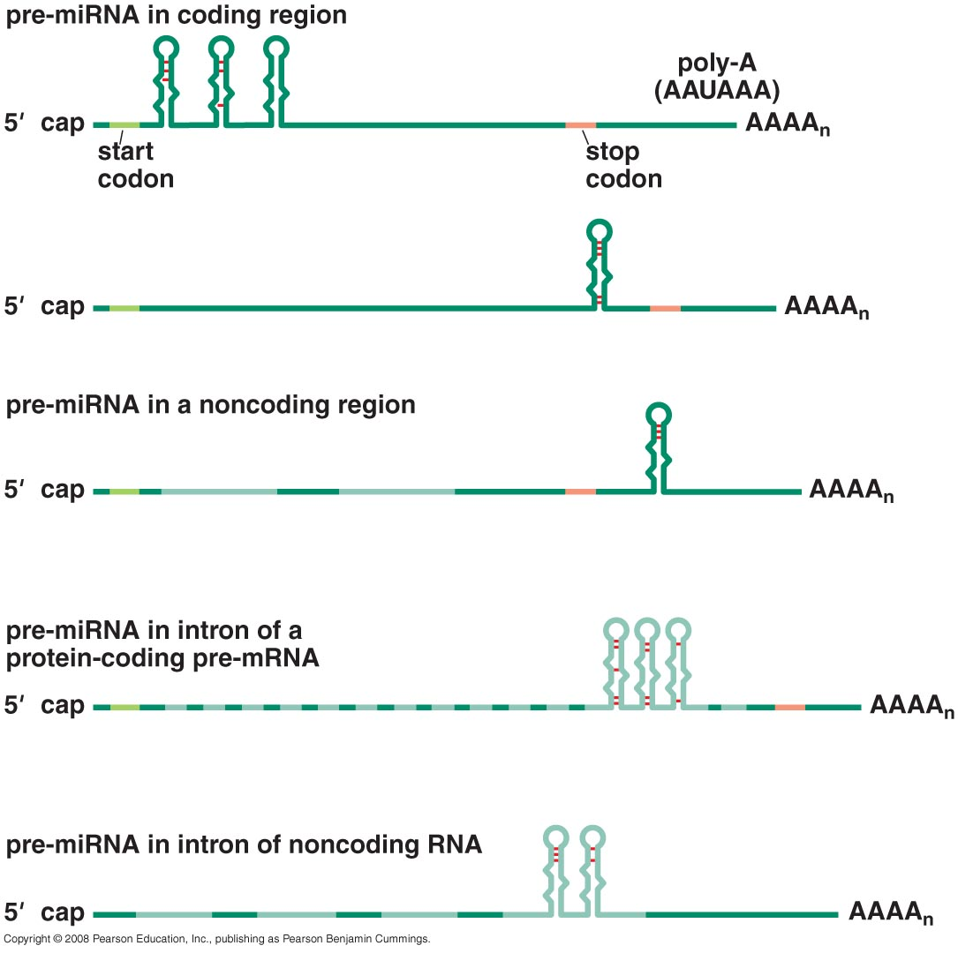
microRNA (miRNA) are encoded by genes located anywhere in the genome

Slide 28
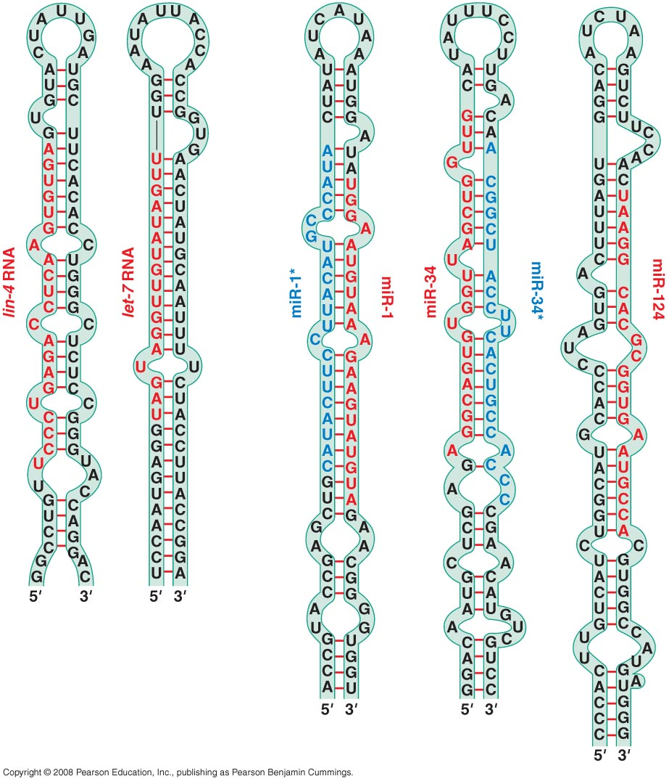
miRNA has a distinctive secondary structure
Hairpin shape
~ 22 nucleotide
Bases 2-9 are “seed residues”
Using bioinformatics
  Could predict their presence in the genome
  Could predict genes they regulate

Slide 29
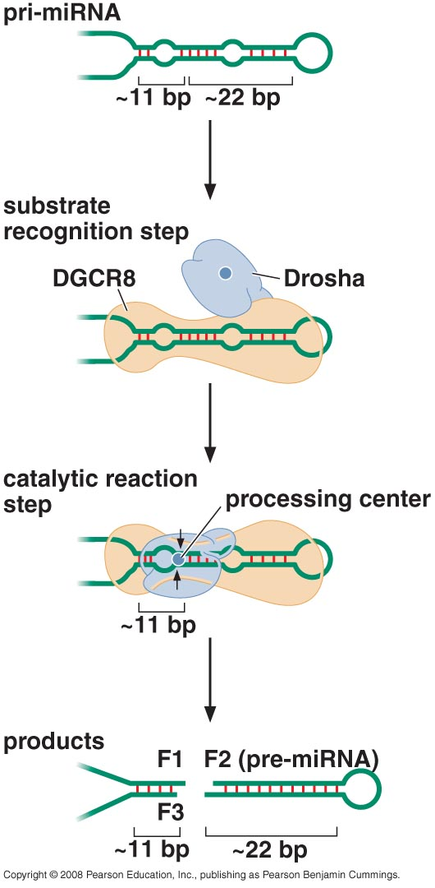
Synthesis of miRNA
Gene encoding miRNA (nucleus)
↓(transcription)
Pri-miRNA
↓(Drosha)
Pre-miRNA (get out to cytoplasm)
↓(Dicer)
Mature-miRNA

Slide 30
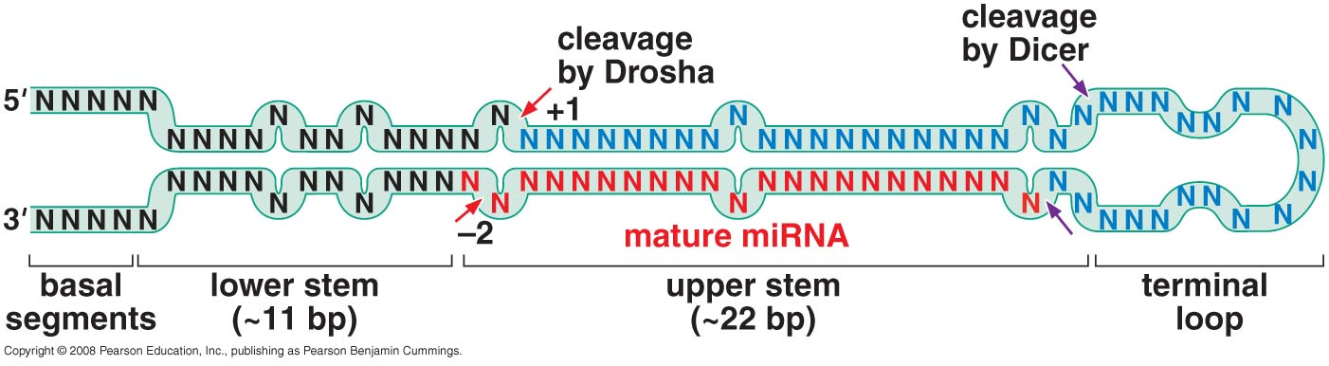
Overview of pri-RNA structure & sites of cleavage
No recognition of specific sequence BUT specific structures
Drosha cuts 11 bp away from dsRNA-ssRNA junction
2 nucleotide overhang at 3` end

Slide 31
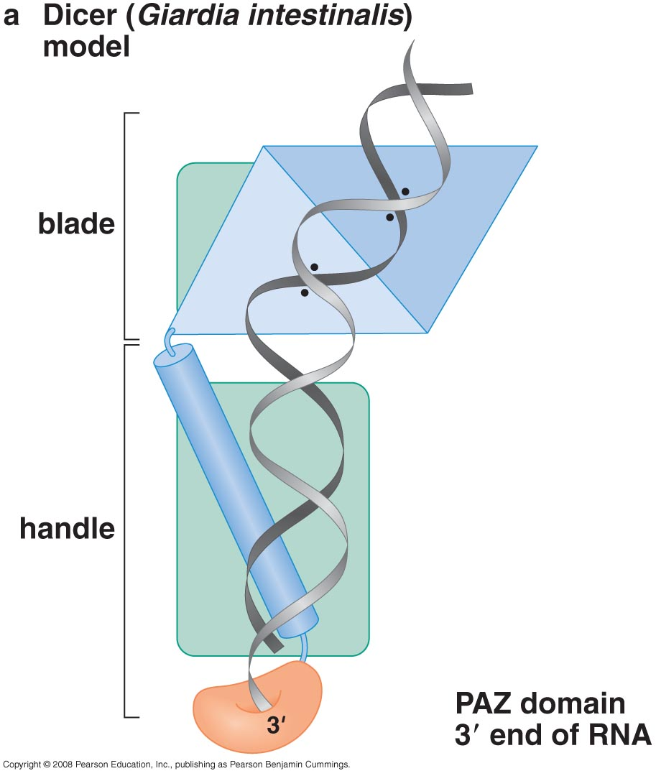
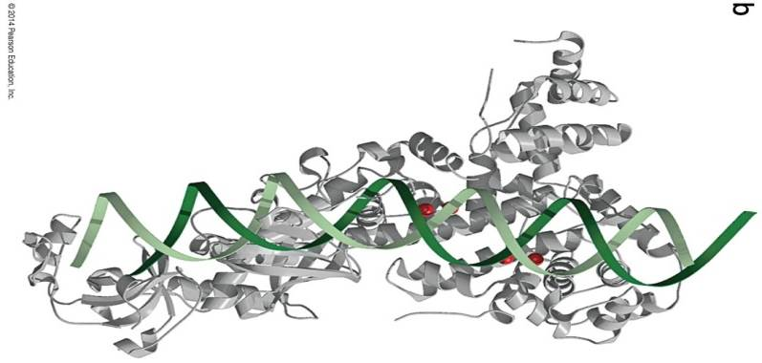
Second cleavage by Dicer
Cleavage sites selected by measuring not sequence specific
Dicer consists of:
  RNA binding domain (PAZ)
  2 RNaseIII domain
Dicer is needed to generate both
  mature miRNA from pre-miRNA
  siRNA

Slide 32
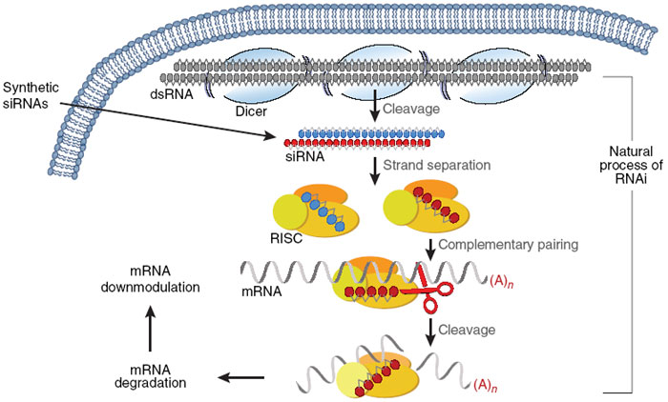
siRNA function
Denatured siRNA is known as guide RNA
Discarded siRNA is known as passenger RNA

Slide 33
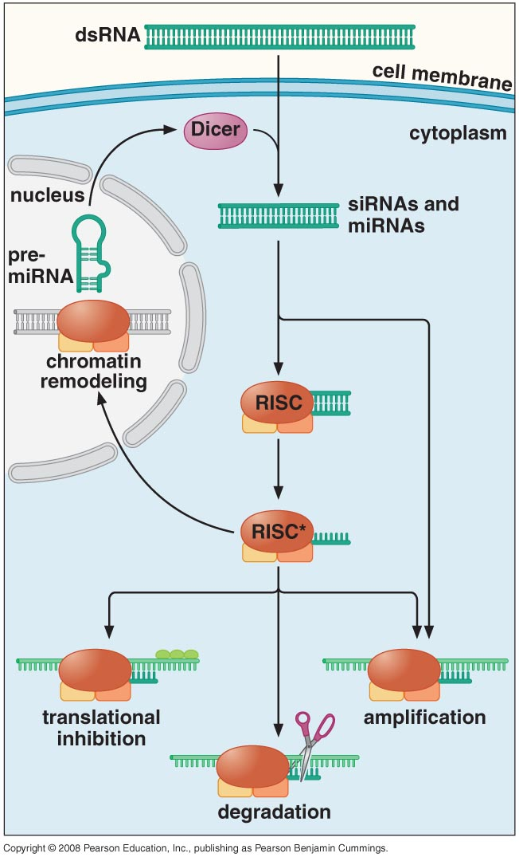
How does regulatory RNA work?
It works by forming a machinery called RNA-induced silencing complex (RISC)
Mature RISC consists of:
  Guide RNA
  Proteins from Argonaute family
Very efficient because of RNA-dependent RNA polymerase (RdRP)

Slide 34
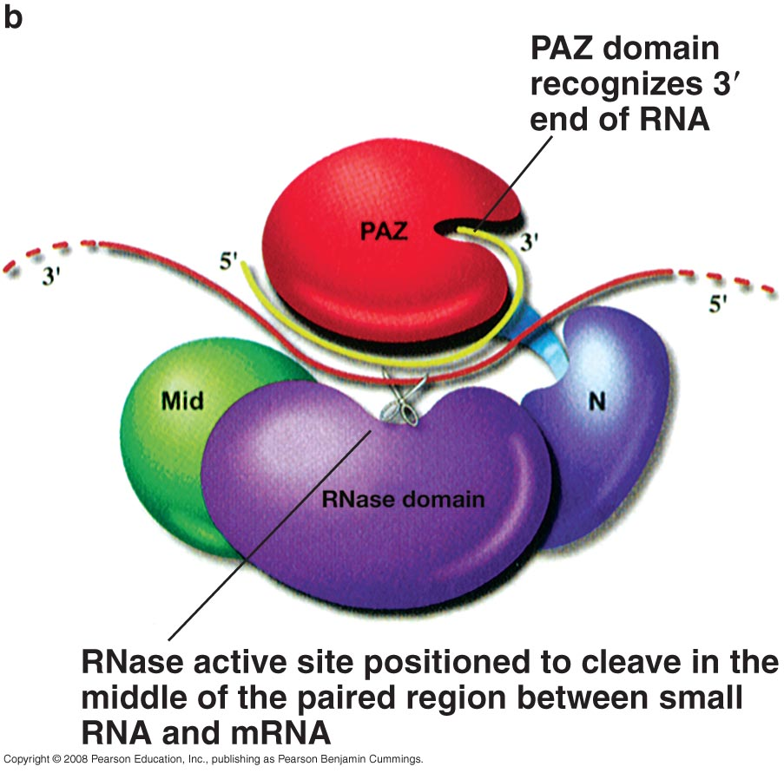
Argonaute structure or RISC complex
PAZ domain:
  recognize 3` end of guide RNA
RNas domain:
  cleave target RNA strand from the middle

Slide 35
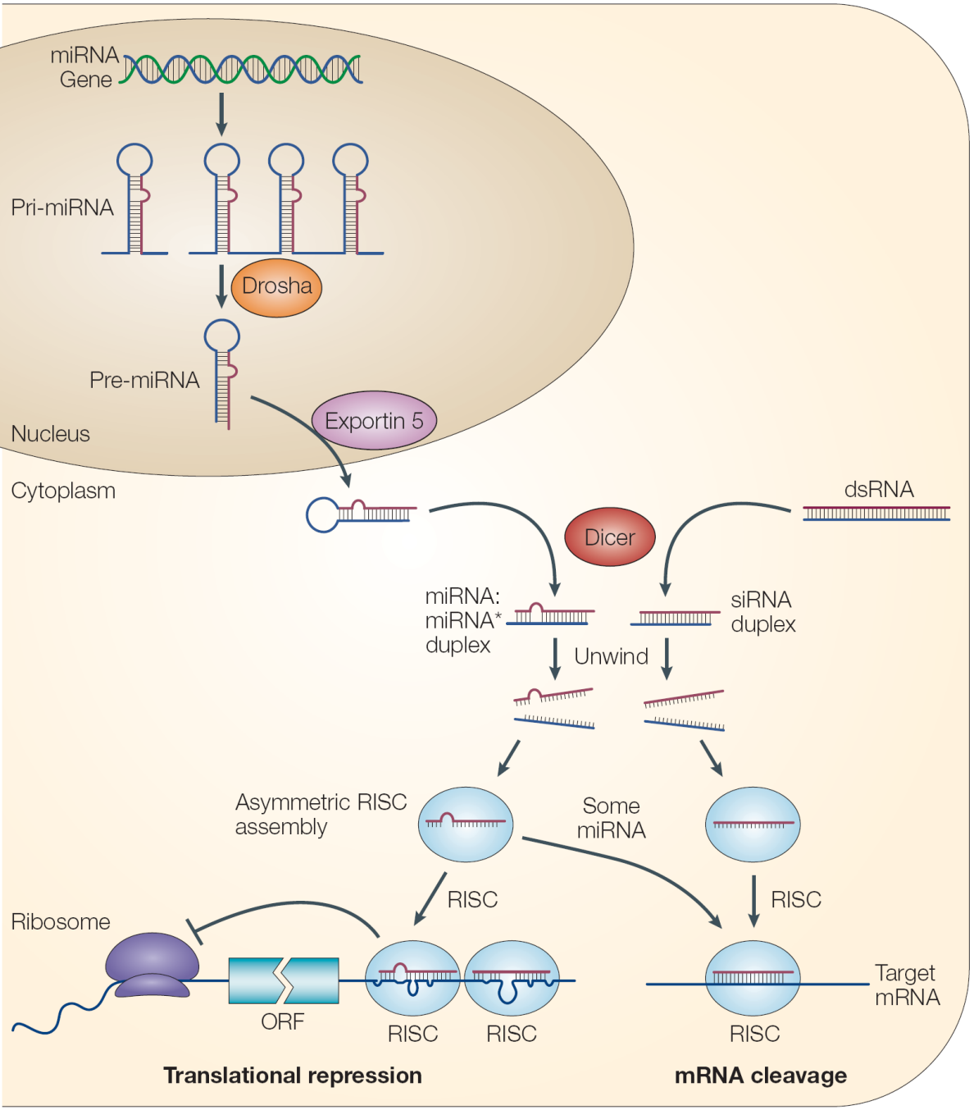
Mechanisms for regulating translation
Sending targeted mRNA to cytoplasmic regions away from translation machinery known as (P bodies) where they accumulate & degraded later
Destabilizing poly A tail

Slide 36
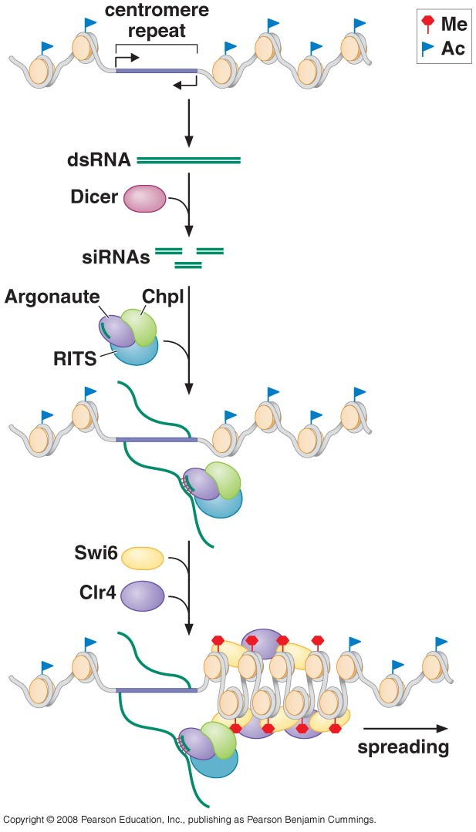
Regulating transcription by gene silencing
Best example is silencing centormere in S.pombe
Both strands in centromere are transcribed creating dsRNA
Silencing is done by machinery similar to RISC RNA-induced transcriptional silencing (RITS)

Slide 37
The evolution & Exploitation of RNAi

Slide 38
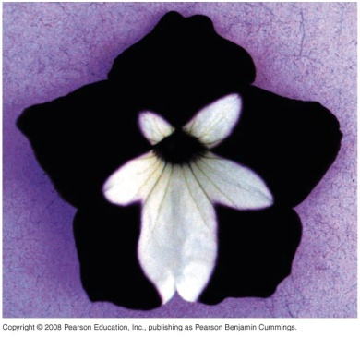
Experiments that led to discover RNA regulatory molecules
Making Petunia flower with deeper purple color by inserting extra copies of the gene into cell resulted in paler flowers
Inserting antisense RNA of par-1 gene to block it action
  The sense RNA which was used as control did the same job
  RNA from other genes did not affect par-1 gene
2006 Nobel prize for the discovery that it is the dsRNA (caused by contamination) which blocked the transcription

Slide 39
Evolution of RNAi
RNAi machinery occurs in most but not all Eukaryotes (S.cerevisiae)
Some Eukaryotes have RNAi machinery but no miRNA

Slide 40
Exploitation (use) of RNAi
Protection against transposons & viruses
Role in cancer pathogenesis
Role in regulating gene translation
Dosage compensation of chromosome X
Regulating gene imprinting
Tool for manipulating gene expression

Slide 41
1-Protection against transposons & viruses
45% of human genome is DNA originated from transposons
RNAi machinery silence transposons by recruiting histone modifiers
  Mutations affecting RNAi machinery could reactivate transposons
RNAi machinery prevent spread of viral infection in plant
  Now viruses modified their genome to includes suppressor of RNAi machinery
    Reducing siRNA stability
    Prevent spreading of siRNA

Slide 42
1-Protection against transposons & viruses
The piRNAs seem particularly dedicated to the task of protecting cells from transposons and are predominantly expressed in the germline (the cells whose protection is most important).
The piRNA clusters contain bits and pieces of transposons “transposon graveyards” and thus the piRNAs generated from transcripts of these regions often target transcripts made by active transposons, inhibiting their action.

Slide 43
1-Protection against transposons & viruses
Similarly to the CRISPR system in bacteria includes a mechanism to actively acquire specimens of invading foreign DNA and uses this to prime the CRISPR arrays to make small RNAs that will target those very same sequences should they turn up in the cell again.
The piRNA system appears to lack this feature, but DNA sequences that end up in piRNA clusters presumably get there by moving themselves into that region, thus the clusters will be enriched for transposon sequences

Slide 44
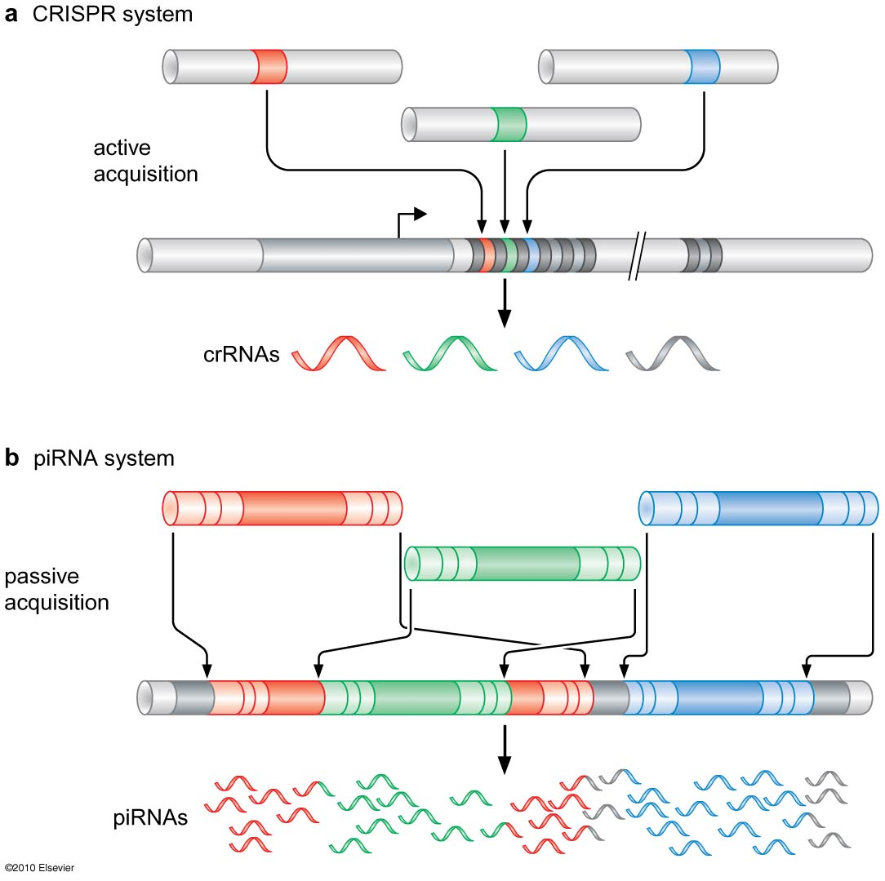

Slide 45
2- Role in cancer pathogenesis
miRNA are classified as:
  Oncogenic: their increased expression lead to cancer
  Tumor suppressor: their absence increase cancer
Half of the identified miRNA (~300) are located at chromosomal regions disrupted by rearrangement in cancer pathogenesis

Slide 46
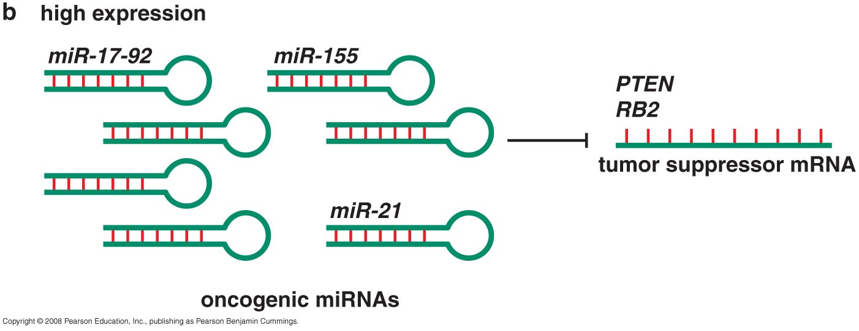
RNAi & human disease -Cancer
Oncogenic miRNA (miR-17-92)
Located in 13q31
Expression of miR-17-92 increased in small cell lung cancer
It target RB2 and E2F1 responsible for regulating cell cycle (tumor suppressor genes)

Slide 47
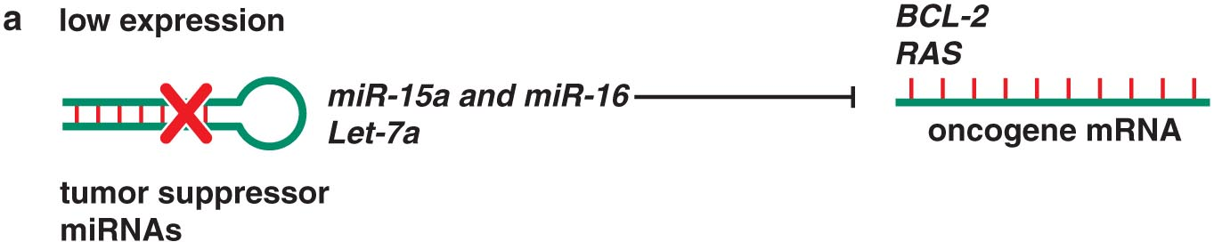
RNAi & human disease - Cancer
Tumor suppressor miRNA (miR-15 & miR-16)
Located in 13q14
Deletion of miR-15 & miR-16 will reduce their expression → chronic lymphocytic leukemia (CLL)
miR15+16 →↓BCL2→↑apoptosis
Deletion of miR15+16 →↑BCL2→↓apoptosis

Slide 48
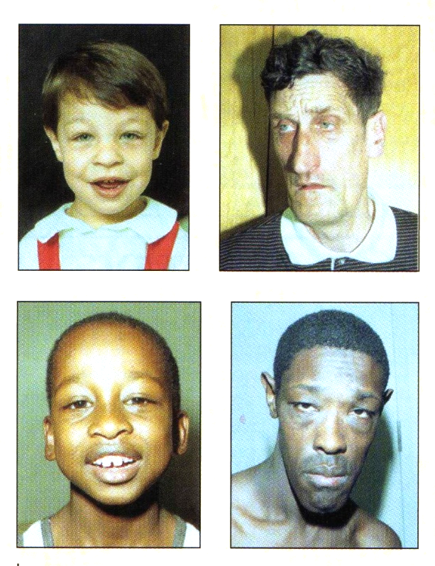
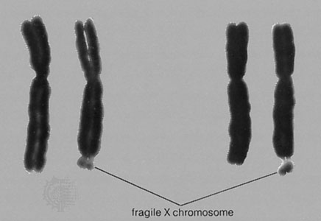
3- Role in regulating gene translation
Fragile X mental retardation
Located at the tip of chromosome X
Encode fragile X mental
retardation protein (FMRP)
Triplet repeat (CGG) expansion mutation (>200) → target the region for methylation → No FMRP→ causes the most common form of inherited mental retardation

Slide 49
Role in regulating gene translation
Fragile X mental retardation
FMRP is RNA binding protein that regulate translation of neuronal expressed mRNA
FMRP was isolated among proteins forming the RISC complex
Fragile X syndrome might be caused by disturbance of RNAi regulatory pathway because of lacking FMRP

Slide 50
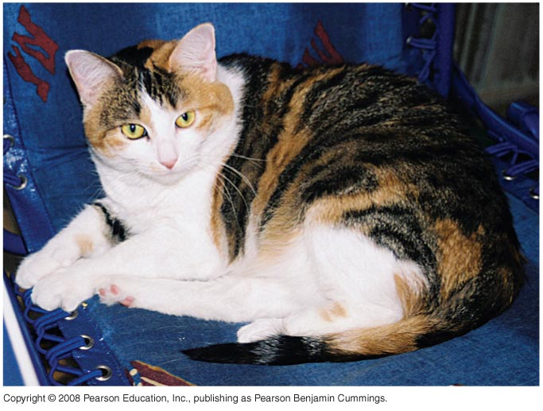
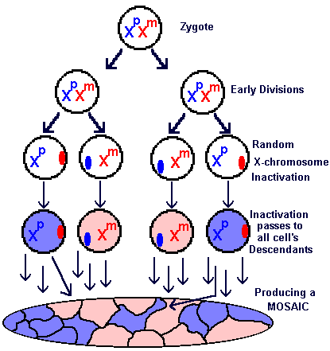
4- Dosage compensation
I- Chromosome X inactivation
Chromosome X inactivation is a way of dosage compensation
Inactivation caused by XIST RNA molecule (X inactivation specific transcript)
XIST is encoded by X inactivation centre gene (Xic)

Slide 51
Which X chromosome to be inactivated?
Determined by another RNA molecule (Tsix) encoded by Xic locus but from the other strand (antisense)
  If Tsix is mutated in maternal X → maternal X will be inactivated
Balance between Xist and Tsix RNA molecule will determine which chromosome will be inactivated

Slide 52
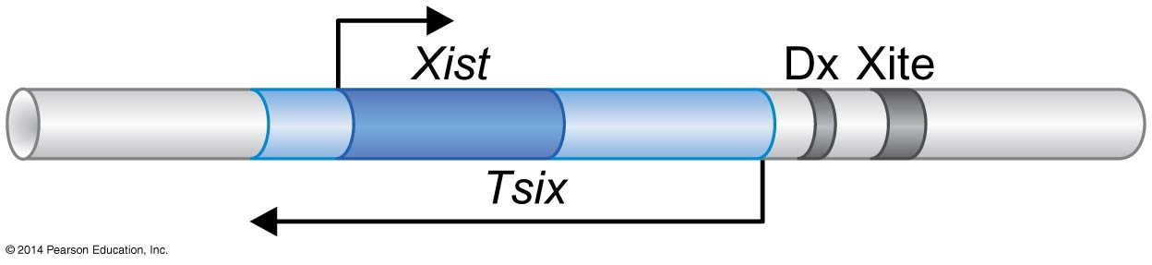
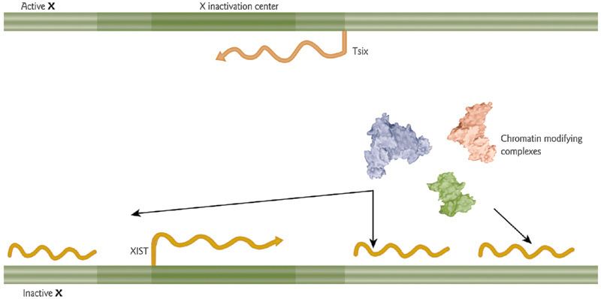
Which X chromosome to be inactivated?

Slide 53
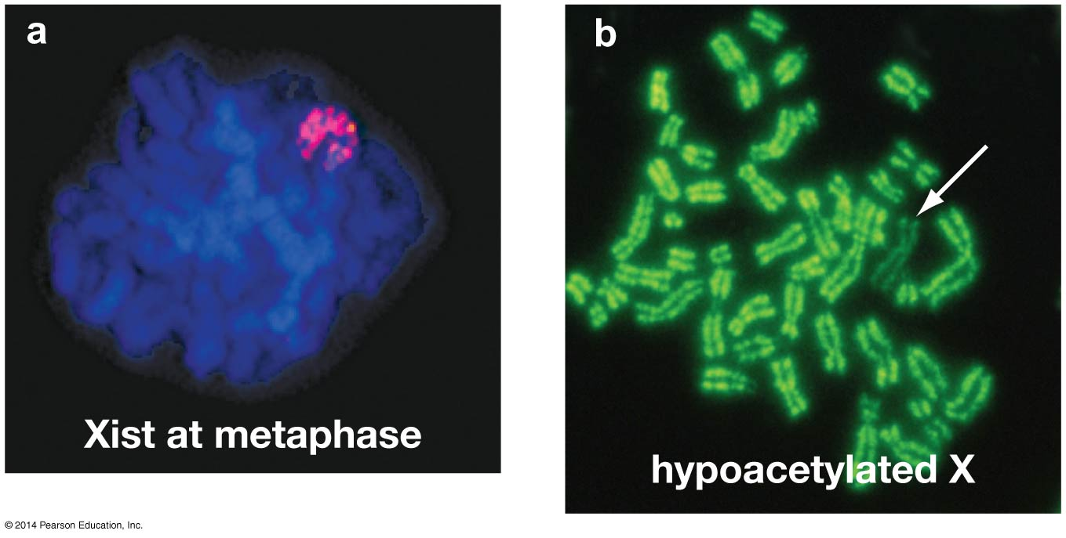
Visualizing X-inactivation: molecular markers.
(a) Localization of XistRNAalong the inactive X chromosomeis shown by in situ hybridization in metaphase cells.
(b) Chromosomes are stained for acetylation on histone H4. inactivated X chromosome, has much lower levels of acetylation than the other chromosomes.

Slide 54
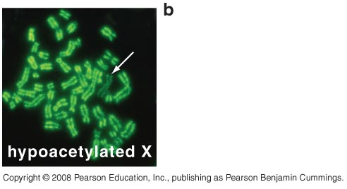
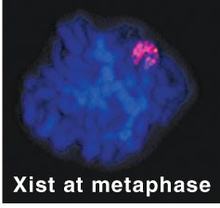
Chromosome X inactivation
Xist RNA coats X chromosome from which it is expressed
Xist RNA recruit other protein to modify and silence chromosome

Slide 55
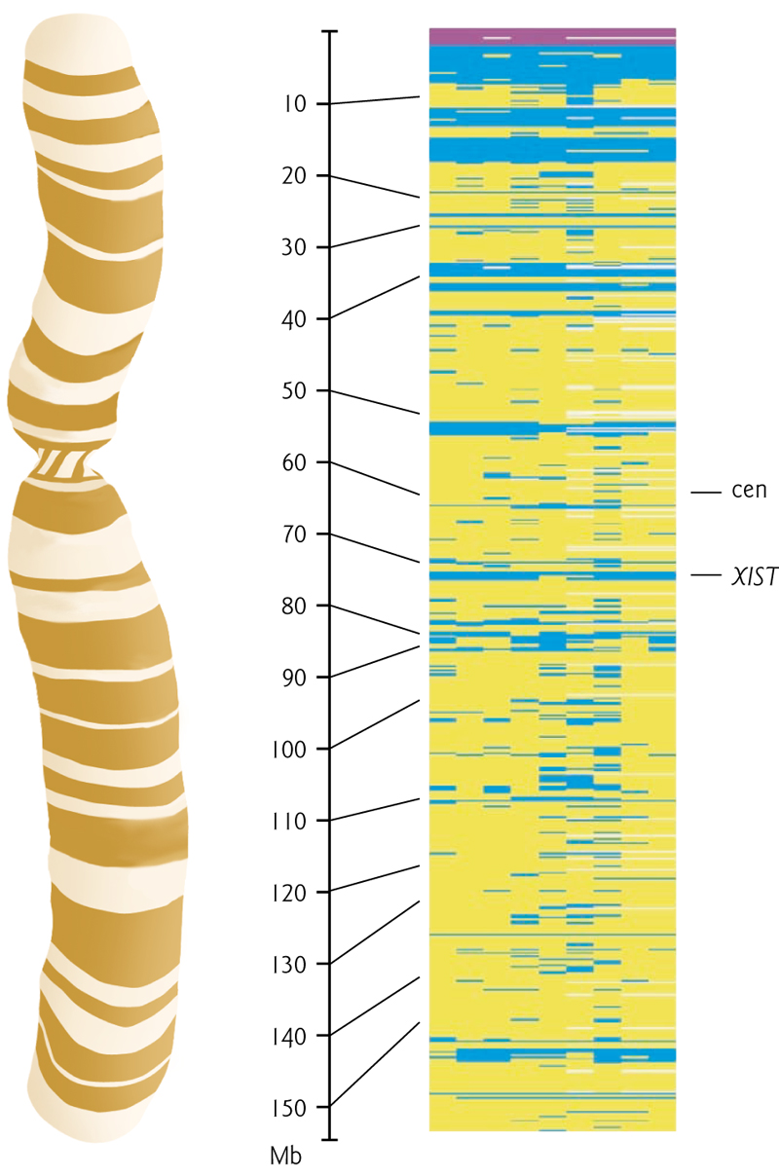
Chromosome X inactivation
Only 75% of genes are silenced in inactive X
Remaining 25% includes genes in “pseudoautosomal” area and adjacent areas

Slide 56
4- Dosage compensation
II- increasing expression of male X genes
Drosophila double the expression of X genes in male
Regulated by non-coding RNA molecules (roX1 & roX2)
  Recruit chromatin modifiers

Slide 57
5- Regulating gene imprinting
Non-coding RNA molecules regulated by imprinting control region (ICR)
Recruit histone and DNA modifiers

Slide 58
6- Tool for manipulating gene expression
Insert RNA to inhibit gene expression → identify its function
It works very well in worms but difficult in mammal cells
The best way to insert RNA to worms is by feeding them with E.coli containing the RNA
Inserting miRNA gene is easier than inserting ds siRNA

Slide 59
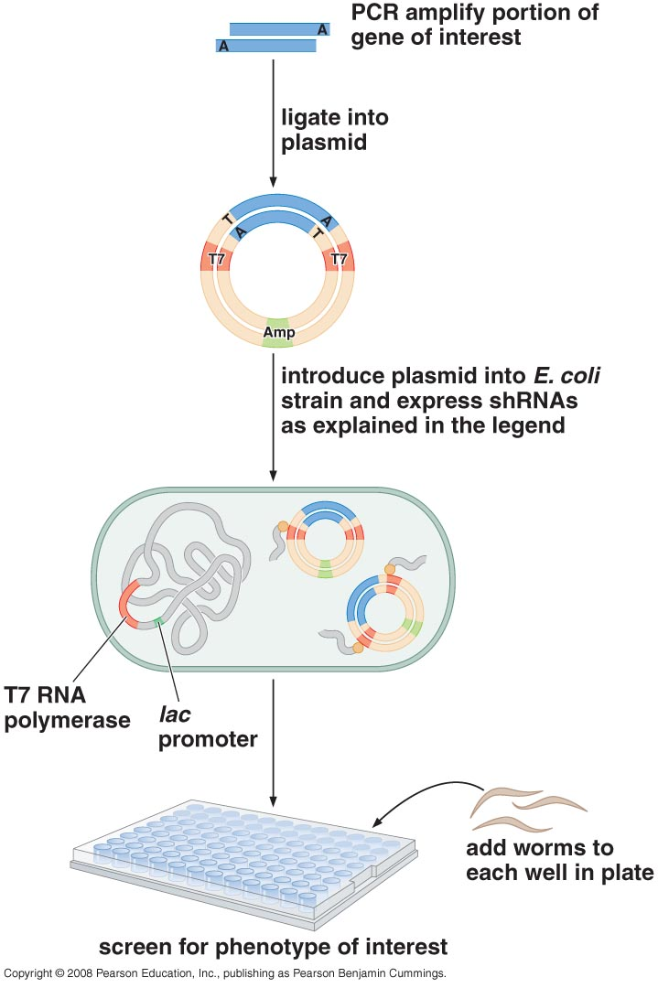
6- Tool for manipulating gene expression
inserting DNA coding for miRNA (short haripin RNA (shRNA))
shRNA transcribed by T7 RNA polymerase
Worms will feed on
these E.coli

Slide 60
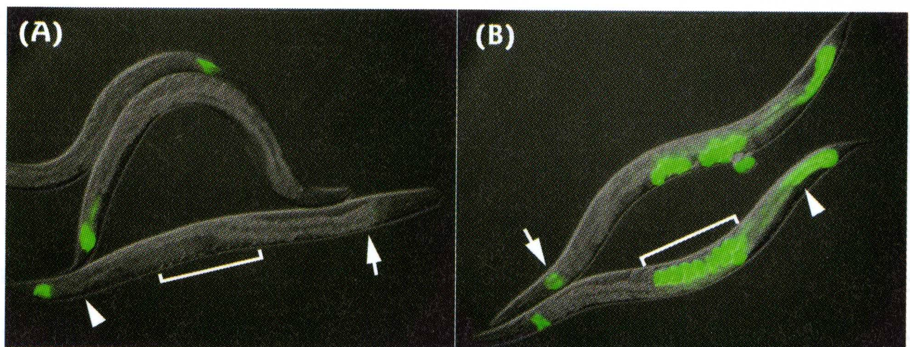
6- Tool for manipulating gene expression
A: worm fed on bacteria expressing GFP dsRNA → shutdown of GFP expression
B: normal worm expressing GFP

